Slide 1

Information Theory and Coding System PMSCS 676 Summer 2016
Prof. Dr. Md. Imdadul Islam
www.juniv.edu

Slide 2
Information Theory
Main objective of a communication system is to convey information. Each message conveys some information where some message conveys more information than other.
From intuitive point of view the amount of information depends on probability of occurrence of the event. If some one says, ‘the sun will rise in the east tomorrow morning’ will not carry any information since the probability of the event is unity.
If some one says, ‘it may rain tomorrow’, will convey some information in winter season since raining is an unusual event in winter. Above message will carry very small information in rainy season. From intuitive point of view it could be concluded that information carried by a message is inversely proportional to probability of that event.

Slide 3
Information from intuitive point of view:
If I is the amount of information of a message m and P is the probability of occurrence of that event then mathematically,
To hold above relation, the relation between I and P will be,
I = log(1/P)
In information theory base of the logarithmic function is 2.

Slide 4
Let us consider an information source generates messages m₁, m₂, m₃,… … …,m_{k} with probability of occurrences, P₁, P₂, P₃,… … …,P_{k}. If the messages are independent the probability of composite message,
P = P₁P₂P₃… P_{k}
Information carried by the composite message or total information,
I_{T} = log₂(1/ P₁P₂P₃… P_{k})
= log₂(1/ P₁)+ log₂(1/ P₂)+ log₂(1/ P₃)+… … … + log₂(1/ P_{k})
= I₁+I₂+I₃+… … … +I_{k}

Slide 5
Information from engineering point of view
From engineering point of view, an amount of information in a message is proportional to the time required to transmit the message. Therefore the message with smaller probability of occurrence needs long code word and that of larger probability need shorter codeword.
For example in Morse code each alphabet is presented by combination of mark and space has a certain length. To maximize throughput frequent letters like e, t, a and o are presented by shorter code word and the letters like x, q, k and z which occur less frequency are presented by longer code word.
If someone use equal length code like binary or gray code then it become unwise to use equal code for frequent letters i.e. throughput (information per unit time) of the communication system will be reduced considerably.

Slide 6
Let the probability of occurrences of letters e and q in an English message is P_{e} and P_{q} respectively. We can write,
If the minimum unit of information is code symbol (bit for binary code) then from above inequality the number of bit required to represent q will be greater than that of e. If the capacity of the channel (in bits/sec) is fixed then time required to transmit q (with larger codeword) will be greater than e (with shorter codeword).

Slide 7
If the capacity of a channel is C (bits/sec) then time required to transmit e,
Similarly, time required to transmit q,
which satisfies the concept of information theory from engineering point of view.

Slide 8
Central idea of information theory is that messages of a source has to be coded in such a way that maximum amount of information can be transmitted through the channel of limited capacity.
Example-1
Consider 4 equiprobable messages M = {s₀, s₁, s₂, s₃}. Information carried by each message s_{i} is,
Bits P_{i} = 1/4
We can show the result in table-1.
Table-1
Messages | Bits
s₀ | 00
s₁ | 01
s₂ | 10
s₃ | 11
What will happen for the information source of 8 equiprobable messages?

Slide 9
Average Information
Let an information source generate messages m₁, m₂, m₃,… … … m_{k} with probability of occurrences, P₁, P₂, P₃,… … … P_{k}. For a long observation period [0, T], L messages were generated, therefore LP₁, LP₂, LP₃,… … … LP_{k} are the number of symbols of m₁, m₂, m₃,… … … m_{k} were generated over the observation time [0, T].
Information source
{m₁, m₂, m₃,… … … m_{k}}
{P₁, P₂, P₃,… … … P_{k}}
Now total information will be,
I_{T} = LP₁log(1/ P₁)+ LP₂log(1/ P₂)+ LP₃ log(1/ P₃)+… … … + LP_{k} log(1/ P_{k})
Average information,
H = I_{T}/L
Average information H is called entropy.

Slide 10
Information Rate
Another important parameter of information theory is information rate, R expressed as:
R = rH bits/sec or bps; where r is symbol or message rate and its unit is message/sec.
Information source
Three messages or symbols
Lower message/symbol rate (r)
Higher message/symbol rate (r)

Slide 11
Message or symbol rate, r = 20 symbols/sec
11
3 bits
Higher message/symbol rate, r = 50 symbols/sec
Let on average each symbol requires 3 bits i.e. H = 3 bits/symbol.
For case 1,
The information rate, R = rH = 20 symbols/sec × 3 bits/symbol
= 60 bits/sec = 60 bpd
For case 2,
The information rate, R = rH = 50 symbols/sec × 3 bits/symbol
= 150 bits/sec = 150 bpd

Slide 12
Example-1
Let us consider two messages with probability of P and (1-P) have the entropy,
Information source
{0,1}
for maxima

Slide 13
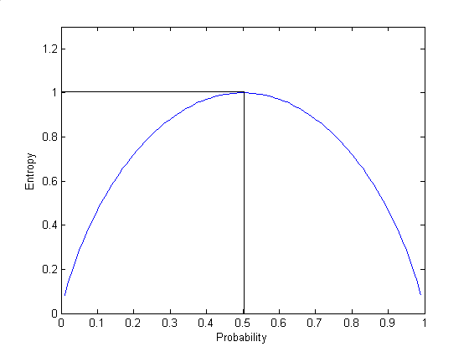
%Matlab Code
p=0:0.01:1;
H=p.*log2(1./p)+(1-p).*log2(1./(1-p));
plot(p,H)
xlabel('Probability')
ylabel('Entropy')

Slide 14
Therefore the entropy is maximum when P = 1/2 i.e. messages are equiprobable. If k messages of equiprobable: 1/P₁=1/P₂ =1/P₃… … … =1/P_{k} = 1/k the entropy becomes,
Unit of entropy is bits/message

Slide 15
Example-1
An information source generates four messages m₁, m₂, m₃ and m₄ with probabilities of 1/2, 1/8, 1/8 and 1/4 respectively. Determine entropy of the system.
H = (1/2)log₂(2)+ (1/8)log₂(8)+ (1/8)log₂(8)+ (1/4)log₂(4) = 1/2+3/8+3/8+1/2 = 7/4 bits/message.
Example-2
Determine entropy of above example for equiprobable message.
Here, P = 1/4
H = 4(1/4)log₂(4) = 2bits/message. The coded message will be 00, 01, 10 and 11.

Slide 16
Example-3
An analog signal band limited to 3.4 KHz sampled and quantized with 256 level quantizer. During sampling a guard band of 1.2 KHz is maintained. Determine entropy and information rate.
For 256 level quantization, number of possible messages will be 256. If the quantized sample are equiprobable then P = 1/256.
H = 256.(1/256)log₂(256) = 8 bits/sample
From Nyquist criteria, Sampling rate,
R = 2× 3.4 +1.2 = 6.8+1.2 KHz = 8KHz = 8×10³samples/sec.
Information rate,
r = Hr = 8× 8×10³bits/sec = 64 ×10³bits/sec = 64Kbps

Slide 17
Ex.1
If entropy, then prove that,

Slide 18
Code generation by Shannon-Fano algorithm:
Message | Probability | I | II | III | IV | V | No. of bite/message
m₁ | 1/2 | 0 |  |  |  |  | 1
m₂ | 1/8 | 1 | 0 | 0 |  |  | 3
m₃ | 1/8 | 1 | 0 | 1 |  |  | 3
m₄ | 1/16 | 1 | 1 | 0 | 0 |  | 4
m₅ | 1/16 | 1 | 1 | 0 | 1 |  | 4
m₆ | 1/16 | 1 | 1 | 1 | 0 |  | 4
m₇ | 1/32 | 1 | 1 | 1 | 1 | 0 | 5
m₈ | 1/32 | 1 | 1 | 1 | 1 | 1 | 5
The entropy of above messages:
H = (1/2)log₂(2)+ 2(1/8)log₂(8)+ 3(1/16)log₂(16)+ 2(1/32)log₂(32)
= 2.31 bits/message
The average codelength,
=1×1/2+2×3×1/8+3×4×1/16+2×5×1/32 = 2.31 bits/message

Slide 19
The efficiency of the code,
= 1 =100%
If any partition of Shannon-Fano is not found equal then we have to select as nearly as possible. In this case efficiency of the coding will be reduced.

Slide 20
Ex.2
Determine Shannon-Fano code
Message | Probability
m₁ | 1/2
m₂ | 1/4
m₃ | 1/8
m₄ | 1/16
m₅ | 1/32
m₆ | 1/64
m₇ | 1/128
m₈ | 1/128

Slide 21
Ex.3
An information source generates 8 different types of messages: m₁, m₂, m₃, m₄, m₅, m_{6,} m₇ and m₈. During an observation time [0, 2hr], the source generates 10,0000 messages; among them the individual types are: 1000, 3000, 500, 1500, 800, 200, 1200 and 1800 (i) Determine entropy and information rate (ii) determine the same results for the case of equiprobable messages. Comment on the results. (iii) Write code words using Shannon-Fano algorithm. Comment on the result iv) determine mean and variance of code length. Comment on the result.

Slide 22
Show that Entropy is maximum when all messages are equiprobable

Slide 23
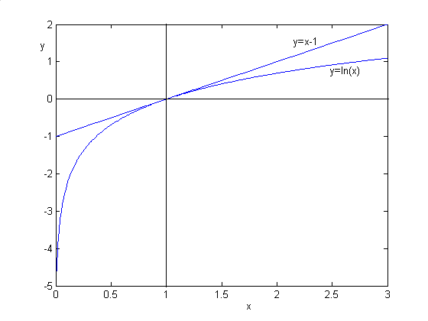
Let an information source generate messages {m₁, m₂, m₃,… … …, m_{k}} with probabilities of occurrence: { P₁, P₂, P₃,… … … P_{k}}. Another source generates same message with different probability distribution like: { q₁, q₂, q₃,… … … q_{k}}.
Let us consider the inequality, ln(x) ≤ x-1 of fig. below. Putting x = p_{i}/q_{i} in above equality,
ln(p_{i}/q_{i}) ≤ p_{i}/q_{i} -1

Slide 24
(1)

Slide 25
If all the messages of second source are equiprobable i.e. P_{i}=1/k then from equation (1),
(1)
(2)

Slide 26
Let us find the entropy of first source for the case of equiprobale message.
(3)
From (2) and (3)
Therefore entropy of an information source is the maximum when all the messages are equiprobable.

Slide 27
Memoryless source and Source with memory:
A discrete source is said to be memoryless if the symbols emitted by the source are statistically independent. If the source is discrete, it is called a discrete memoryless source (DMS). For example an information source generates symbols x₁, x₂, x₃, … … … x_{m} with probability of occurrence p(x₁), p(x₂), p(x₃), … … … p(x_{m}). Now the probability of generation of sequence, (x₁, x₂, x₃, … x_{k}) is:

Slide 28
A discrete source is said to have memory if the source elements composing the sequence are not independent. Let us consider the following binary source with memory.
P(0|0) = 0.95
P(1|0) = 0.05
0
1
P(1|1) = 0.55
P(0|1) = 0.45
The entropy of the source X is,

Slide 29
Which is the weighted sum of the conditional entropies that correspond to the transition probability.
Here
From probability theorem,
From the state transition diagram,
P(0) = 0.9, P(1) = 0.1

Slide 30
= 0.9×0.286+0.1×0.933 = 0.357 bits/symbol

Slide 31
Let us consider the following binary code:
Message/symbol | Code
a | 00
b | 01
c | 10
d | 11

Slide 32
Again for three tuple case:
Message /symbol | Code
a | 000
b | 100
c | 001
d | 111
e | 110
f | 011
g | 010
h | 101
etc.

Slide 33
Channel Capacity
Channel Capacity is defined as the maximum amount information a channel can convey per unit time. Let us assume that the average signal and the noise power at the receiving end are S watts and N watts respectively. If the load resistance is 1Ω then the rms value of received signal is volts and that of noise is volts.
Therefore minimum quantization interval must be greater than
volts, otherwise smallest quantized signal could not be distinguished from the noise. Therefore maximum possible quantization levels will be,

Slide 34
If each quantized sample presents a message and probability of occurrence of any message will be for equiprobable case. The maximum amount of information carries by each pulse or message, bits.
If the maximum frequency of the baseband signal is B, then sampling rate will be 2B samples/sec or message/sec. Now the maximum information rate,
bits/sec
Above relation is known as the Hartly-Shanon law of channel capacity.

Slide 35
In practice N is always finite hence the channel capacity C is finite. This is true even bandwidth B is infinite. The noise signal is a white noise with uniform psd over the entire BW. As BW increases N also increases therefore C remains finite even BW is infinite.
Let the psd of noise is N₀/2 therefore the noise of received signal,
N = 2BN₀/2 = BN₀
N
X(f)
N₀/2
f
f
B
B

Slide 36
Putting
Now
which is finite

Slide 37
Channel Capacity
Let us now consider an analog signal of highest frequency of B Hz is quantized into M discrete amplitude levels.
The information rate, R = (sample/sec)*(bits/sample) = 2B. log₂M = 2Blog₂2^{n} = 2Bn. If the coded data has m different amplitude levels instead of binary data of m = 2 levels then, M = m^{n}; where each quantized sample is presented by n pulses of m amplitude levels.
Now the channel capacity,
C = 2B.log₂(m^{n}) = 2Bn.log₂(m) = Bn.log₂(m²)

Slide 38
Let us consider m = 4 of NRZ polar data for transmission.
3a/2
a/2
-a/2
-3a/2
t
0
Fig.1 NRZ polar data for m = 4 levels
The amplitude of possible levels for m levels NRZ polar data will be, ±a/2, ±3a/2, ±5a/2, … … …, ±(m-1)a/2

Slide 39
The average signal power,
S = (2/m){(a/2)²+(3a/2)²+(5a/2)²+ … … … +(m-1)²(a/2)²}
= (a²/4) (2/m){1²+3²+5²+ … … … +(m-1)²}
=(a²/4) (2/m)
S= a²(m²-1)/12
The prove of sum of square of odd numbers is shown in appendix
C = Blog₂(1+S/N )bits/sec
C = Bn.log₂(m²)
If the level spacing is k times the rms value of noise voltage σ then, a = kσ.

Slide 40
If the signal power S is increased by k²/12 the channel capacity will attain the Shannon’s capacity.
Here n represents the number of pulses of base m per sample and B for samples/sec. Therefore Bn is number of pulses of base m/sec is represented as W as the BW of the baseband signal.
Therefore
If the signal power S is increased by k²/12 the channel capacity will attain the Shannon’s capacity.

Slide 41
Appendix
1²+3²+5²+… … …+(2n-1)²
The rth term, T_{r} = (2r-1)² = 4r²-4r+1
Therefore
Putting n = m/2

Slide 42
Source Coding
The process by which data generated by a discrete source is represented efficiently called source coding. For example data compression.
Lossless compression
Prefix coding (no code word is the prefix of any other code word)
Run-length coding
Huffman Coding
Lempel-Ziv Coding
Lossy compression
Example: JPEG, MPEG, Voice compression, Wavelet based compression

Slide 43
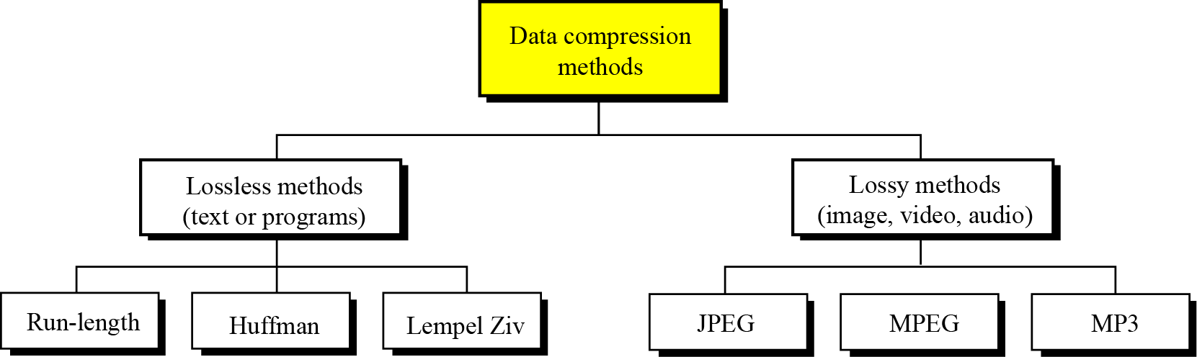
Figure 1 Data compression methods

Slide 44
Run-length encoding
Run-length encoding is probably the simplest method of compression. The general idea behind this method is to replace consecutive repeating occurrences of a symbol by one occurrence of the symbol followed by the number of occurrences.
The method can be even more efficient if the data uses only two symbols (for example 0 and 1) in its bit pattern and one symbol is more frequent than the other.

Slide 45
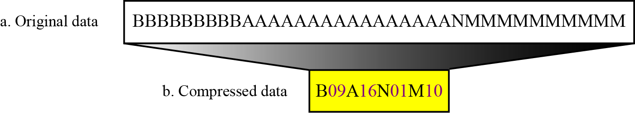
Figure 1 Run-length encoding example

Slide 46
Example-3
Consider a rectangular binary image
0 0 0 0 0 0 0 0 0 0 0 0 0 0 0 0 0 0 0 0 0 0 0 0 0 0 0 0 0 0 0 0
0 0 0 0 0 0 0 0 0 0 0 0 0 0 0 0 0 0 0 0 0 0 0 0 0 0 0 0 0 0 0 0
0 0 0 0 0 0 0 0 0 1 1 1 1 0 0 0 0 0 0 0 0 0 0 0 0 0 0 0 0 0 0 0
0 0 0 0 0 0 0 0 0 0 0 0 0 0 0 0 0 0 0 0 0 0 0 0 0 0 0 0 0 0 0 0
0 0 0 0 0 0 0 0 0 0 0 0 0 0 0 0 0 1 1 1 1 1 0 0 0 0 0 0 0 0 0 0
0 0 0 0 0 0 0 0 0 0 0 0 0 0 0 0 0 0 0 0 0 0 0 0 0 0 0 0 0 0 0 0
0 0 0 0 0 0 1 1 1 1 1 1 1 1 1 1 1 0 0 0 0 0 0 0 0 0 0 0 0 0 0 0
The image can be compressed with run-length coding like:
0, 32
0, 32
0, 9, 1, 4, 0, 19
0, 17, 1,5, 0,10
0,32
0,6, 1,11, 0,15

Slide 47
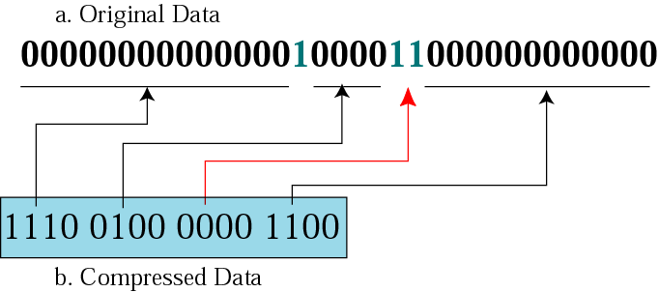
Run-length encoding for two symbols
We can encode one symbol which is more frequent than the other.
This example only encode 0’s between 1’s.
There is no 0 between 1’s

Slide 48
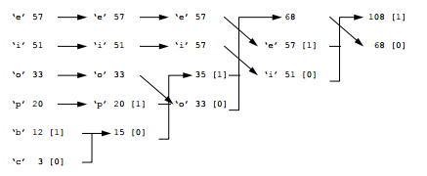
Huffman coding
Huffman coding uses a variable length code for each of the elements within the information. This normally involves analyzing the information to determine the probability of elements within the information. The most probable elements are coded with a few bits and the least probable coded with a greater number of bits.
The following example relates to characters. First, the textual information is scanned to determine the number of occurrences of a given letter. For example:
‘e’ ‘i’ ‘o’ ‘p’ ‘b’ ‘c’
57 51 33 20 12 3
The final coding will be:
‘e’ 11
‘i’ 10
‘o’ 00
‘p’ 011
‘b’ 0101
‘c’ 0100

Slide 49
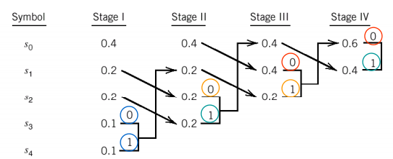
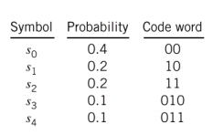
Example-2

Slide 50
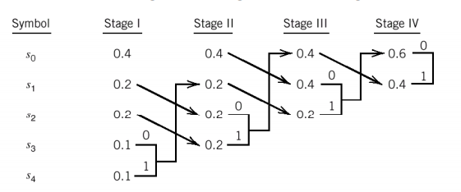
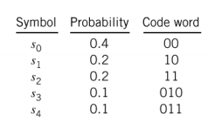
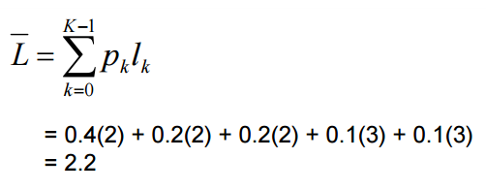
Example-3
Average code length
bits/message

Slide 51
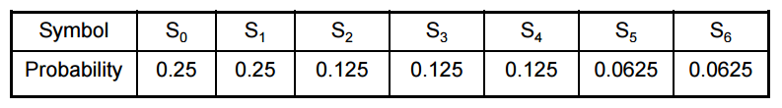
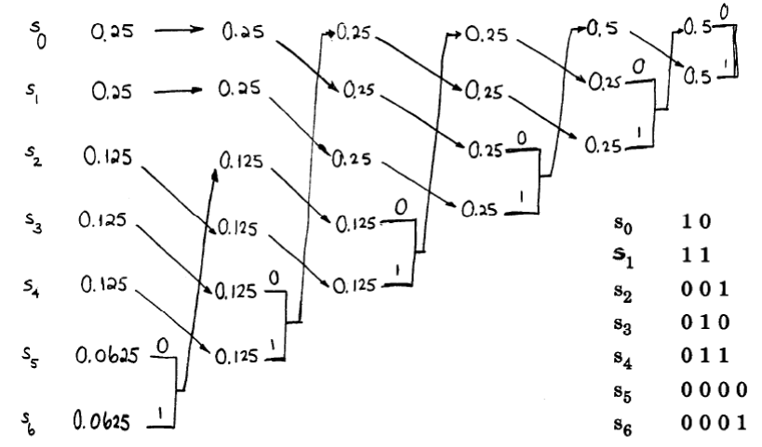

Slide 52
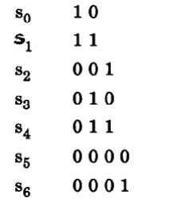
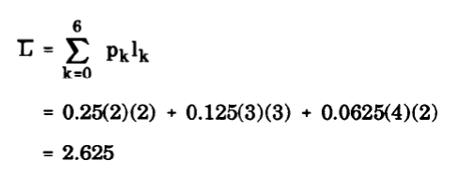
Average code length
bits/message

Slide 53
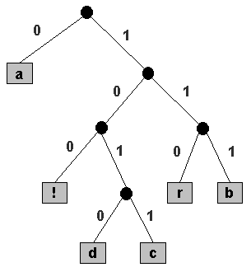
Prefix Codes
No word in the code is a prefix of any other word.
a 0
b 111
c 1011
d 1010
r 110

Slide 54
Lempel Ziv encoding
Lempel–Ziv–Welch (LZW) is a universal lossless data compression algorithm created by Abraham Lempel, Jacob Ziv, and Terry Welch. It was published by Welch in 1984 as an improved implementation of the LZ78 algorithm published by Lempel and Ziv in 1978.
The algorithm is simple to implement, and widely used Unix file compression, and is used in the GIF image format.

Slide 55
Compression
In this phase there are two concurrent events: building an indexed dictionary and compressing a string of symbols. The algorithm extracts the smallest substring that cannot be found in the dictionary from the remaining uncompressed string. It then stores a copy of this substring in the dictionary as a new entry and assigns it an index value.
Compression occurs when the substring, except for the last character, is replaced with the index found in the dictionary. The process then inserts the index and the last character of the substring into the compressed string.

Slide 56
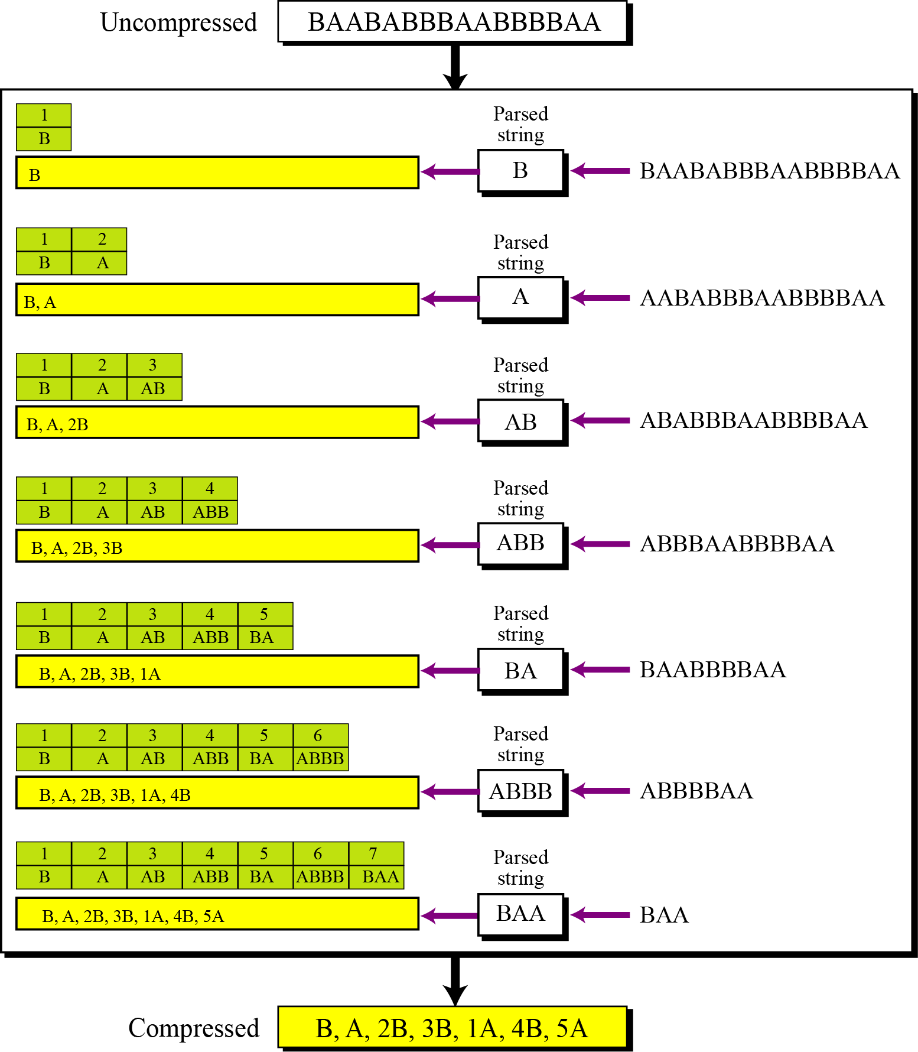
Figure 15.8 An example of Lempel Ziv encoding

Slide 57
Decompression
Decompression is the inverse of the compression process. The process extracts the substrings from the compressed string and tries to replace the indexes with the corresponding
entry in the dictionary, which is empty at first and built up gradually. The idea is that when an index is received, there is already an entry in the dictionary corresponding to that index.

Slide 58
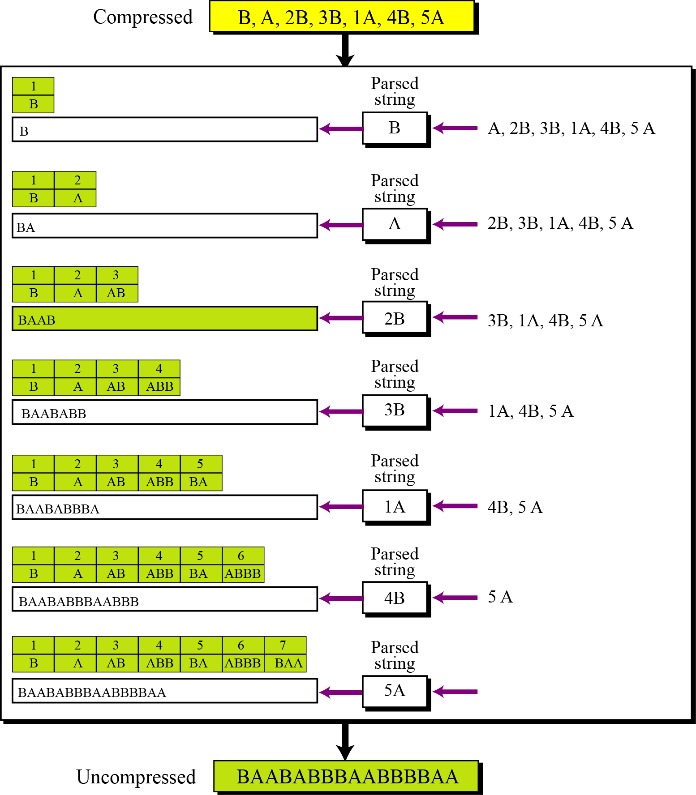
Figure 15.9 An example of Lempel Ziv decoding

Slide 59
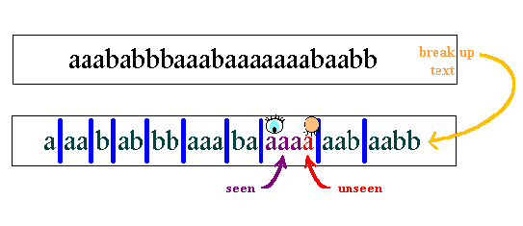
Rule: Separate this stream of characters into pieces of text so that the shortest piece of data is the string of characters that we have not seen so far.

Slide 60
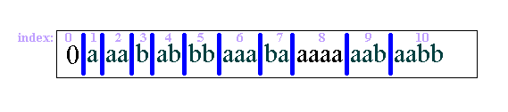
Sender : The Compressor
Before compression, the pieces of text from the breaking-down process are indexed from 1 to n:

Slide 61
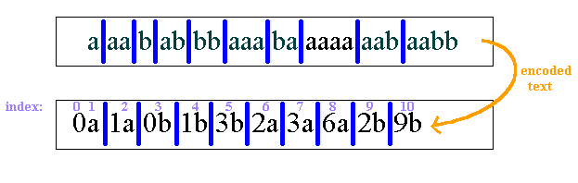
indices are used to number the pieces of data.
The empty string (start of text) has index 0.
The piece indexed by 1 is a. Thus a, together with the initial string, must be numbered Oa.
String 2, aa, will be numbered 1a, because it contains a, whose index is 1, and the new character a.

Slide 62

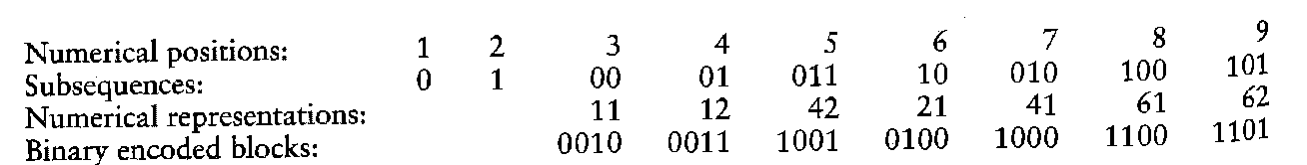
Example-1

Slide 63
A drawback of Huffman code is that it requires knowledge of a probabilistic model of source: unfortunately, in practice, source statistics are not always known a priori.
When it is applied to ordinary English text, the Lampel-Ziv algorithm achieves a compaction of approximately 55%. This is to be contrasted with compaction of approximately 43% achieved with Huffman coding.

Slide 64
Let's take as an example the following binary string: 001101100011010101001001001101000001010010110010110
String | Position Number of this string | Position Number in binary
0 | 1 | 0001
01 | 2 | 0010
1 | 3 | 0011
011 | 4 | 0100
00 | 5 | 0101
0110 | 6 | 0110
10 | 7 | 0111
101 | 8 | 1000
001 | 9 | 1001
0010 | 10 | 1010
01101 | 11 | 1011
000 | 12 | 1100
00101 | 13 | 1101
001011 | 14 | 1110
0010110 | 15 | 1111

